Slide 1



Week 8: Constitutions and courts
Dr Fredrick Ajwang

Slide 2
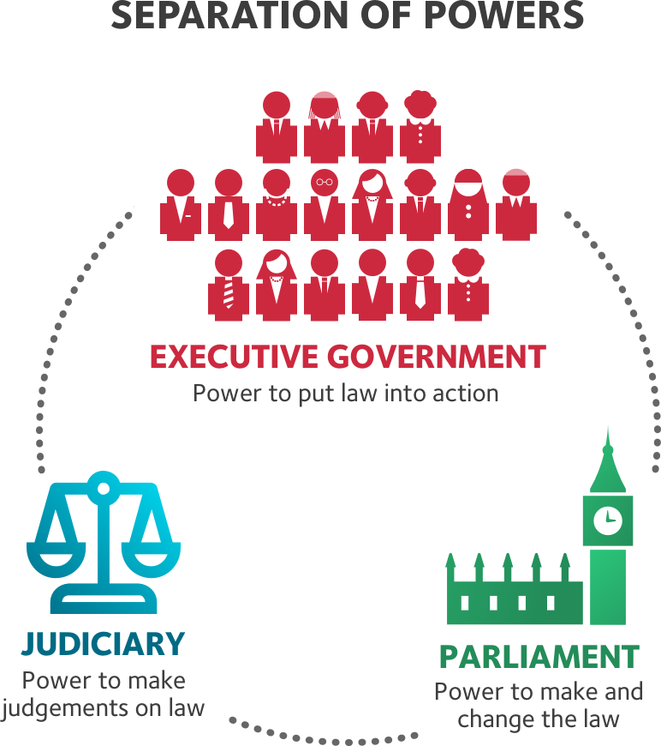
Overview
Constitutions and constitutionalism
The American model
The European model
The power of the judges

Slide 3
Constitutions
A body of ‘meta-norms that governs the production and application of all other
norms’ (Stone Sweet 2017: 161)
A ‘power map containing a set of principles and rules, that outlines the structure and powers of a system of government, describing its institutions and the manner in which they work and relate to one another, and typically describing both the limits on governmental power and the rights of citizens’ (Hague, Harrop and McCormick 2016: 109)
Provisions of a frame of government (Sartori 1994: 198)
‘A system of effective, regularized restraints upon government action’ (Friedrich 1937: 104)

Slide 4

Character of Constitutions
Most constitutions comprise:
Preamble: a stirring declaration of principles and, sometimes, a definition of the state’s purposes.
Organizational section: the powers and structure of government institutions.
Bill of rights: individual and, often, group rights, including access to legal redress.
Procedures for amendment: the procedure for revising the constitution
Notes:
Preamble, tend to set broad aspirations, declaring in vague but often inspiring terms the ideals of the state. It tend to seek popular support for the document.
The organization section then sets outs the institutional structure of government: how the different offices are elected or appointed, and what they are allowed and not allowed to do.
The bill of rights will then outline the rights of citizens relative to government. Guarantees civil rights and liberties to the individual—like freedom of speech, press, and religion. It also sets rules for due process of law.
Finally, there will be a description of the rules on amending the constitution.

Slide 5
Preambles
We the People of the United States, in Order to form a more perfect Union, establish Justice, insure domestic Tranquility, provide for the common defense, promote the general Welfare, and secure the Blessings of Liberty to ourselves and our Posterity, do ordain and establish this Constitution for the United States….
WE, THE PEOPLE OF INDIA, having solemnly resolved to constitute India into a SOVEREIGN SOCIALIST SECULAR DEMOCRATIC REPUBLIC and to secure to all its citizens:
JUSTICE, social, economic and political;
LIBERTY of thought, expression, belief, faith and worship….
We, the people of Kenya--
ACKNOWLEDGING the supremacy of the Almighty God of all creation:
HONOURING those who heroically struggled to bring freedom and justice to our land:
PROUD of our ethnic, cultural and religious diversity, and determined to live in peace and unity as one indivisible sovereign nation….
We, the citizens of Her Majesty's United Kingdom of Great Britain and Northern Ireland, hereby recognise this as our constitution; We do so in the desire to establish justice, liberty and equality for all citizens of our country
In the Name of God, the Merciful, the Compassionate
We, the representatives of the Tunisian people, members of the National Constituent Assembly,
Taking pride in the struggle of our people for independence, to build the state, for freedom from tyranny…
The Democratic Constituent Congress invoking Almighty God, obeying the mandate
of the Peruvian people, and remembering the sacrifice of all the preceding
generations of our land, has resolved to enact the following Constitution….

Slide 6
Codified vs uncodified
A constitution is codified if:
It is set out in a single document.
Drawn up at a particular point in time. E.g. USA constitution; written in 1787 and ratified in 1788.
Went into force on a given date; USA constitution operational from 1789, Kenyan 2011, Indian 1950, South African 1997.
Formalised: ‘This is how things are done’

Slide 7
Codified
Easily consulted and interpreted
Cannot be frivolously tampered with.
It reduces clash of functions of the arms of government.
Cons
Difficult to amend.
Rigid and inflexible usually demanding super majorities.
Rigidity offers the general benefit of a stable political framework, and benefits rulers by limiting the damage should political opponents obtain power, because they would face the same barriers to change.
Least amended: United States (27 in 226 years).
Most amended: Mexico (more than 500 changes in just under 100 years).
(Hague, Harrop and McCormick 2016: 113)

Slide 8
Uncodified
Uncodified constitution is spread among a range of documents and is influenced by tradition and practice.
For instance: Britain, Israel, New Zealand, Saudi Arabia.
E.g. the U.K. uncodified constitution contains
i) Conventions such as the office of Prime Minister
ii) Treaties
iii) Precedents i.e. case law
(iv) Institutions such as the House of Commons
iv) Acts of Parliament, for instance, the European Communities Act 1972; and
v) Fundamental principles.
Tradition and informal rules: ‘This is how we do things’

Slide 9
Codified vs uncodified
Uncodified constitutions are dynamic, flexible and more amenable to constitutional reforms.
In the United Kingdom it allowed the devolution of significant powers to Scotland and Wales in
1999 without much constitutional fuss.
The UK constitution often described as a “living constitution” because it evolves and adapts to reflect changing social attitudes such as the Marriage (Same-Sex Couples) Act 2013.
However, the absence of a written constitution means that the UK does not have a single, written document that has a higher legal status over other laws and rules.
The constitution is less accessible, transparent and intelligible.
The powers of the executive, legislative and judicial branches are not clearly defined either, which can lead to ambiguity, uncertainty and possible conflict between the three pillars of government.
The flexible nature of uncodified constitutions means that they could be subject to multiple interpretations. E.g the opposing interpretations taken by the executive and judiciary regarding the prerogative power to prorogue i.e. suspend Parliament in 2019.

Slide 10
Constitutional Amendments
Flexible constitution: One that can be amended more easily, often in the same way that ordinary legislation is passed. E.g. UK & New Zealand
Rigid constitution: One that is entrenched, requiring more demanding amendment procedures. E.g. USA A two-thirds majority in both houses of the legislature and approval by three-quarters of the states.
Entrenchment: The existence of special legal procedures for amending a constitution. May set up a high-level requirements for constitutional amendments. E.g France & Turkish republican character of the state cannot be amended

Slide 11

Source: Comparative Constitutions Project n.d

Slide 12
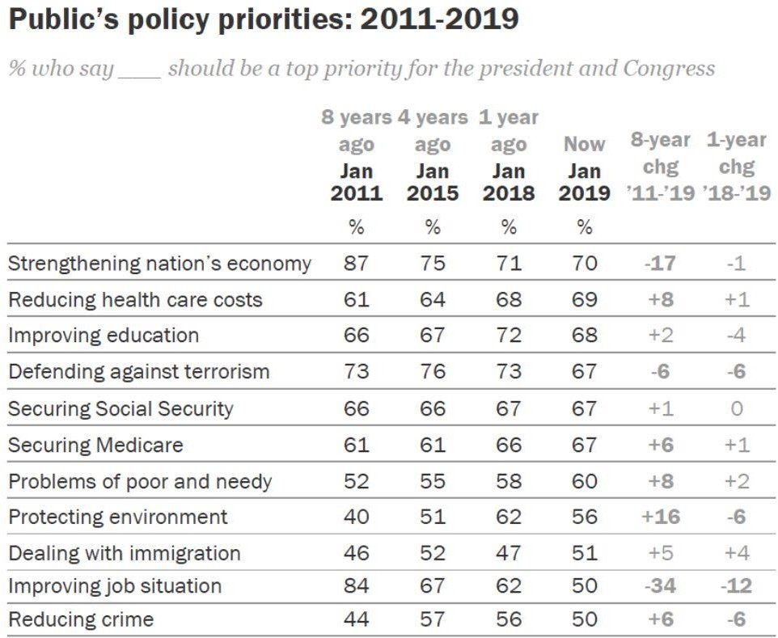

Pew Research Centre 2019

Slide 13
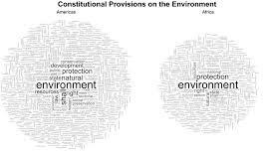
The U.S. Constitution does not say anything about protecting the environment.
According to Constitute, there are 157 Constitutions that speak directly about the environment. E.g. Portugal, Colombia, Kenya.
For example, some provide for a duty of the state to protect the environment.

Slide 14
Courts
Courts enforce constitutional provisions by striking down offending laws and practices
They have the power to override the decisions and laws produced by the government
In a political system, they strike down laws and constrain the power of elected rulers, thereby stabilizing and limiting democracy
The courts do this through a judicial review:
They review the constitutionality of a statute or treaty,
Nullify laws that contravene the constitution.
Review the actions of public sector bodies in terms of their lawfulness
Review administrative regulation for consistency with either a statute, a
treaty, or the Constitution itself (Gallagher, Laver and Mair 2011)

Slide 15
American Judicial Review | European Constitutional Review
Decentralized. All judges possess the power to void or refuse to apply a statute on the grounds that it violates the constitution. | Centralized. Only the constitutional court may annul a statute as unconstitutional.
The Supreme Court is a court of ‘general jurisdiction’: it is the highest court of appeal in the legal order, for all issues of law, not just constitutional issues. But only selects cases it believes raises significant constitutional questions | The Constitutional Court’s jurisdiction is restricted to resolving constitutional disputes only. The ordinary courts handle civil issues and criminal matters.
Judicial review is ‘concrete’ –courts reviews cases where the law has already been applied or is about to be applied. Specific interpretation of the law. | Constitutional review is typically ‘abstract’: determines the constitutionality of a statute or government practice without any reference to a specific case. Broad interpretation of the law. Stone Sweet 2017:160.

Slide 16
Variations among constitutional courts
Constitutional courts vary along the following dimensions:
a) The range of their jurisdiction and powers
E.g. Germany; very broad powers including judicial review, adjudication of disputes between state and federal political institutions, protection of individual rights, and protection of the constitutional and democratic order (Conradt, 2008: 253).
b) The parties who have access to these courts; In Kenya any party
c) The mode of appointment of their judges; Germany, 16 judges appointed by the legislature
d) The tenure of those judges; Germany non-renewable term of 12 years.
e) The effect of judicial declarations of unconstitutionality
f) The ease or difficulty of reversing constitutional-court decisions (Horowitz 2006: 128)

Slide 17
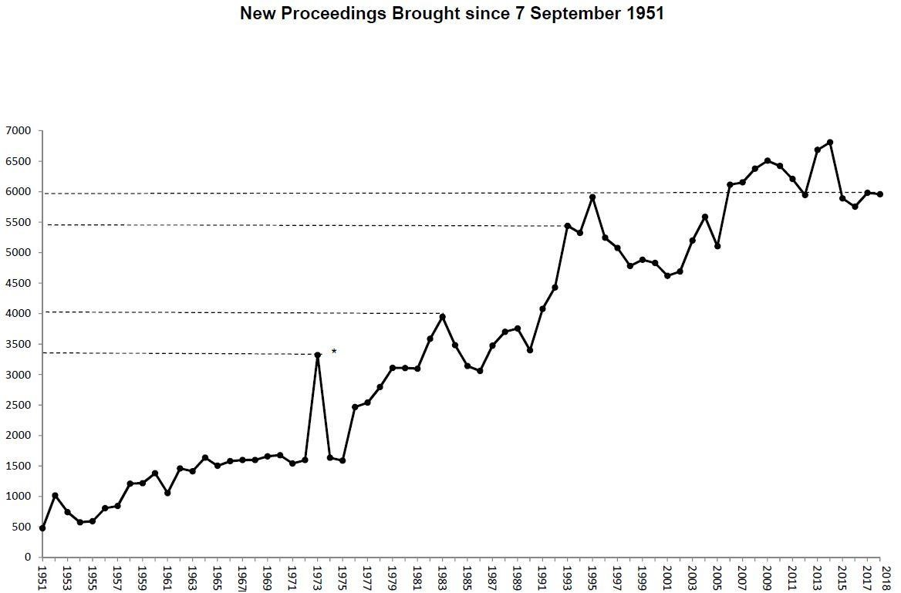
Source: German Federal Constitutional Court 2018
The German Federal Constitutional court- wide jurisdiction over all constitutional matters
Defends rights and federal arrangements, exercises abstract and concrete review; also receives constitutional complaints

Slide 18
The UK Supreme Court
Since 2009; The Supreme Court, as well as being the final court of appeal, plays an important role in the development of United Kingdom law.
As an appeal court, The Supreme Court cannot consider a case unless a relevant order has been made in a lower court.
The final court of appeal for all United Kingdom civil cases, and criminal cases from England, Wales and Northern Ireland
Concentrates on cases of the greatest public and constitutional importance
Maintains and develops the role of the highest court in the United Kingdom as a leader in the common law world’’ (UK Supreme Court n.d)
It cannot overturn any primary legislation made by Parliament. However, it can overturn secondary legislation.
Primary legislation is an Act that has been passed by the Parliament. Secondary legislation can make small changes to an existing Act.

Slide 19
Constitutions as incomplete contracts
To Stone Sweet (2017), constitutions are incomplete contracts between the rulers and those ruled; at the time of contracting, future contingencies are unknown.
They are negotiated by elites/representatives mostly in key moments such as when establishing a democracy.
All contracts generate a demand for a dispute resolution and enforcement by third- party; courts plays this role.
As a (political) contract; comprises a system of principal and agent; where the principal, delegates some authority to the agent to represent him or to act on his behalf. Courts (agent), legislature (principal)
Hence, delegating authority to the constitutional judges ensures interpretation and enforcement
Constitutional courts can be conceptualised as trustees of the constitution with caretakers' responsibilities

Slide 20
Constitutions: Principal and Agent
‘European constitutions are relational contracts, par excellence’; relational contracts are based upon a relationship of trust between the principal and agents.
The citizens as principals have delegated broad powers to the constitutions and the courts to govern and control those in authority.
Hence, a move from the old to the new constitutionalism:
Old constitutionalism: a system of legislative sovereignty, in which governments and parliamentarians (that is, political parties) governed without much of external control.
New constitutionalism: a system of trusteeship in which governments and parliaments are being governed by rules and processes largely outside of their control’ (Stone Sweet 2002: 89)

Slide 21
Courts as Trustees
Ordinary judge:
The judge’s principal is the parliament, and the judge has a clear mandate.
The judge will apply the will of the parliament - as that will is expressed in legislation.
However, European judiciaries engage in such extensive interpretation of the various legal codes.
The principal remains in charge: if ministers or parliamentarians notice that a judge has applied a statutory provision in a way that they did not intend and do not like, the law can be changed.

Slide 22
Agency and Trusteeship
Constitutional judge:
Has to regulate the actions of the government and parliament.
Has the duty to control the exercise of legislative authority and all of those acts pursuant to the adoption of statute.
‘Depending upon the relevant constitutional rules in place, the legislature may be able to overturn constitutional decisions, or restrict the constitutional court’s powers.
The 2018 Hungarian example – decreasing the powers of the court
But only if they can reconstitute themselves as a jurisdiction capable of amending the constitutional law’ (Stone Sweet 2002: 89).

Slide 23
Zone of discretion
The relationship between the principal and agent determined by the zone of discretion
A “ zone of discretion ” — the strategic environment — in which any court operates and is determined by:
( a ) the sum of powers delegated to the court and possessed by the court as a result of its own accreted rulemaking minus
( b ) the sum of control instruments available for use by nonjudicial authority to shape (constrain) or annul (reverse) outcomes that emerge as the result of the court’s performance of its delegated tasks.
The zone of discretion is, by definition, unusually large.
In some places and in some domains, the discretionary powers enjoyed by
constitutional courts are close to unlimited.
Nothing in delegation theory can tell us what constitutional courts will actually do with their discretion (Stone Sweet 2007: 79).

Slide 24
Veto power
Ministers and parliamentarians govern with constitutional judges (Stone Sweet 2002).
The courts hold in effect a sort of veto power over many important political decisions (Kuhn
2006).
Constitutional judges are ‘negative’ legislators whose legislative authority is restricted to the annulment of statute when it conflicts with the law of the constitution (Kelsen 1928).
Such annulments are rare, but often spectacular, political events.
Important legislation vetoed by constitutional courts include the liberalisation of abortion in Germany (1975, 1992) and Spain (1985), the bid to introduce affirmative action in France (1982).
Occasionally the courts are involved in the actual rewriting of the laws or providing general guidelines about how the law should be amended. Thus they have a ‘positive’ impact upon the substance of legislation.
Constitutional judges have also come to exercise substantial, ‘indirect’ authority over legislating, to the extent that case law, in any given policy domain, meaningfully guides the decision making of legislators in that domain.

Slide 25
Veto power
Judicial veto is dependent on three variables:
the ideological composition of the court; liberal or conservative (USA)
the pattern of government control;
and the legislative procedures.’ (Brouard and Hönnige 2017: 529)
These may determine the extent of judicial intervention in public policy.
Restraint judges should apply the letter of the law, leaving politics to elected bodies.
Or Judicial activism: willingness of judges to venture beyond narrow legal reasoning so as to influence public policy.

Slide 26
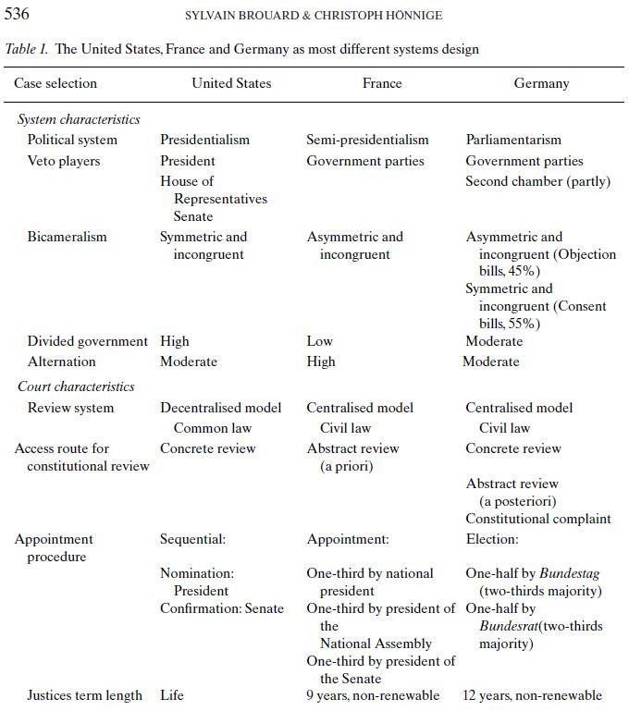
Findings
Courts are not always absorbed as
veto players:
Absorption varies between 11 and 71 per cent in the three systems.
Furthermore, the pattern of absorption is specific in each country due to government control, court majority and legislative procedure
Therefore, it can be concluded that
they are conditional veto players.
Brouard and Hönnige 2017

Slide 27
Conclusions
Constitutions and constitutionalism
Two types of review
The American model
The European model
Systems of constitutional review are effective if judges have the ability to interpret the constitutionality
In many places, judges have become powerful policy-makers.

Slide 28
References
Brouard, Sylvain, and Christoph Hönnige (2017). Constitutional Courts as Veto Players: Lessons from the United States, France and Germany. European Journal of Political Research 56(3): 529-552.
Gallagher, Michael, Michael Laver, and Peter Mair (2011). Representative government in modern Europe. McGraw-Hill. Horowitz 2006
Horowitz, Donald (2006). Constitutional Courts: A Primer for Decision Makers. Journal of Democracy 17(4): 125-136
Sartori, Giovanni (1994). "Constitutional Engineering." In Comparative Constitutional Engineering, pp. 197-204. Palgrave Macmillan, London.
Stone Sweet, Alec (2000). Governing with judges: constitutional politics in Europe. OUP Oxford.
Stone Sweet, Alec (2002). Constitutional Courts and Parliamentary Democracy. West European Politics 25(1): 77-100
Stone Sweet, Alec (2007). The politics of constitutional review in France and Europe. International Journal of Constitutional Law 5.1 : 69-92.
Stone Sweet, Alec (2017) "Constitutions and judicial power." In D. Caramani (ed.) Comparative Politics. Oxford University Press.

